Slide 1


Microsoft 365 Collaboration Conference May 2023 Roadmap Slides Summary
Compiled by Susan Hanley (With Help from Mark Kashman!)
@susanhanley
www.susanhanley.com
sue@susanhanley.com
Updated: May 7, 2023

Slide 2
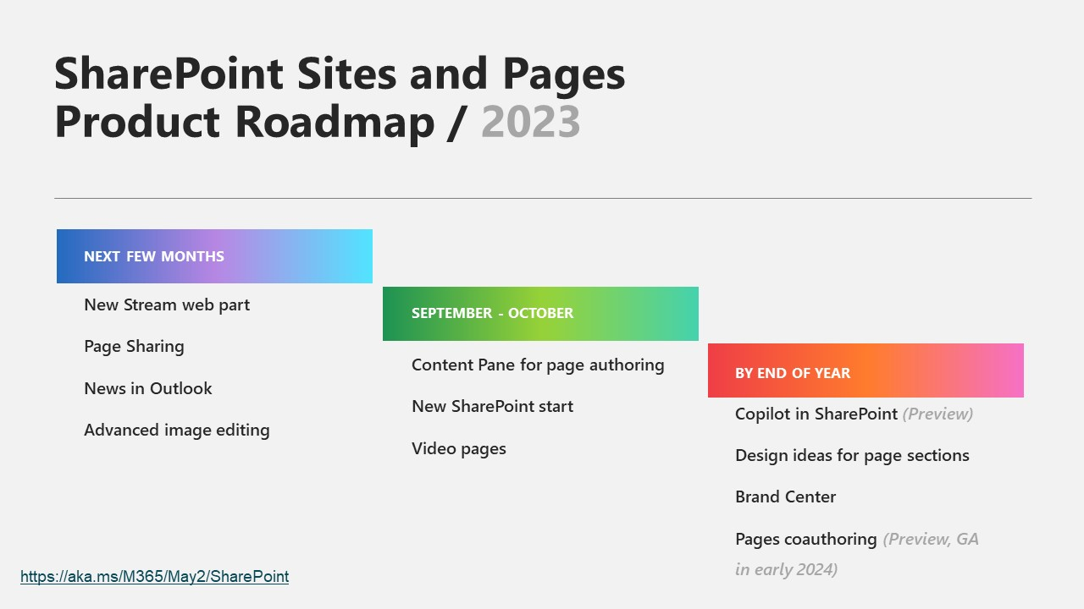
SharePoint Sites + Pages

Slide 3
Timing As of May 2023 Microsoft 365 Roadmap | Microsoft 365
Roadmap Item | Roadmap ID | Target Timing
Microsoft Stream: New Webpart Configure Stream videos inside your pages by supporting single and multiple videos from folders | 124800 | Preview: June 2023 Rollout Start: July 2023
SharePoint News in Outlook Send full news posts from SharePoint to Outlook. 6 new page templates that work in both SharePoint and Outlook. New analytics. | 124803 | Rollout Start: July 2023
Page Sharing Share pages and news without having to share the entire site. | 124822 | Rollout Start: July 2023
Video Pages Create video centric page content, like highlighting meeting content or executive messages with new video pages templates. These templates will be available in both SharePoint and Stream. | 124823 | Rollout Start: August 2023
New SharePoint Start New SharePoint start experience aims to inspire content creators to use their platform. By emphasizing a user- friendly approach that minimizes clicks, it's now easier to create websites, pages, news, and intranet content. Creators can return to the start experience hub to refine drafts, review past work, and monitor engagement metrics | 124824 | Rollout Start: September 2023
Advanced Image Editing Webpart New advanced editing capabilities available in the Image web part will include adjustments, filters, and markup. | 124825 | Rollout Start: July 2023
Content Pane for SharePoint Pages and News The content pane surfaces relevant authoring tools that help authors quickly browse and add content to SharePoint pages. With this new feature, authors can easily drag and drop web parts, media, and section templates for creating rich and engaging pages. | 124827 | Rollout Start: October 2023

Slide 4
Timing As of May 2023 Microsoft 365 Roadmap | Microsoft 365
Roadmap Item | Roadmap ID | Target Timing
Centrally manage branding (Brand Center) New branding and management capabilities | 124838 | Rollout Start: December 2023
Copilot in SharePoint Copilot in SharePoint combines the power of Large Language Models (LLMs), your data in the Microsoft Graph, and best practices to create engaging web content. Use a brief prompt to generate custom sites and pages with content hierarchy, design, and sample content that aligns with user needs. | 124840 | Rollout Start: November 2023
Resource Specific Consent Introduction of new selected permissions and APIs to support granting applications permissions at all of the levels where it is possible to break inheritance today. This will apply to applications operating in either delegated or app- only mode. | 124842 | Rollout Start: December 2023
Microsoft SharePoint: Application Site Creation without Sites.FullControl.AII Currently an application requires Sites.FullControl.AII to create new site collections within a tenant. This work will allow applications to use a new scope, Sites.Create.AII, to create new site collections without accessing any existing content. During the site creation process, the application can request access to the new site, allowing for provisioning scenarios with reduced tenant permissions. | 124843 | Rollout Start: December 2023
Designer for SharePoint Pages Page authors can leverage the MSFT Designer service to improve the look and feel of their SharePoint pages. This is done through tailored section level design suggestions. | 124846 | Rollout Start: January 2024
Co-authoring for SharePoint Pages Multiple people can edit SharePoint pages similar to co-authoring for documents. | 124853 | Rollout Start: March 2024

Slide 5
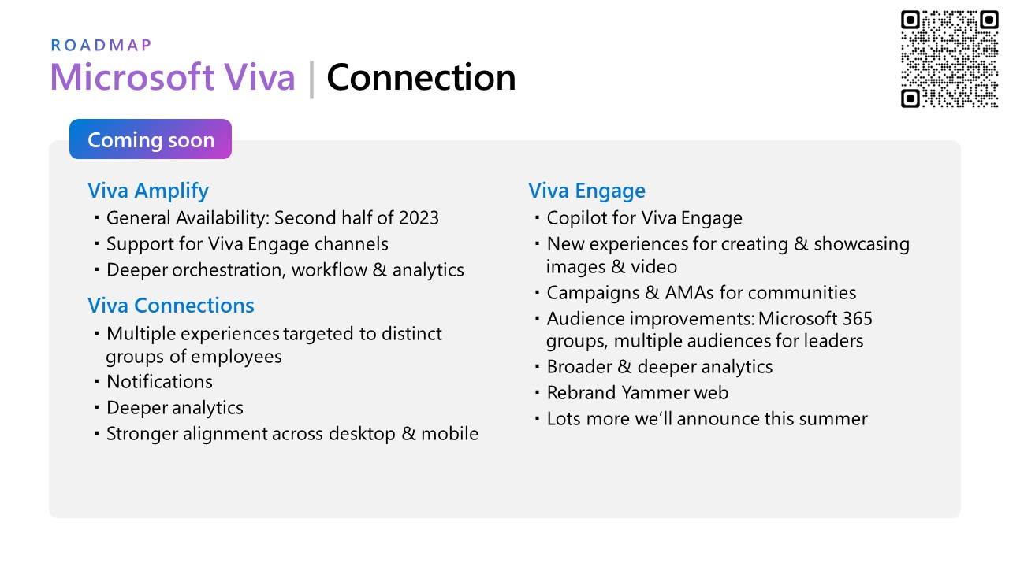
Microsoft Viva Connection Pillar

Slide 6
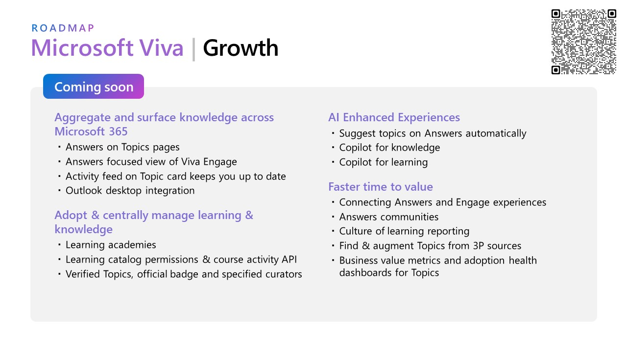
Microsoft Viva Growth Pillar

Slide 7
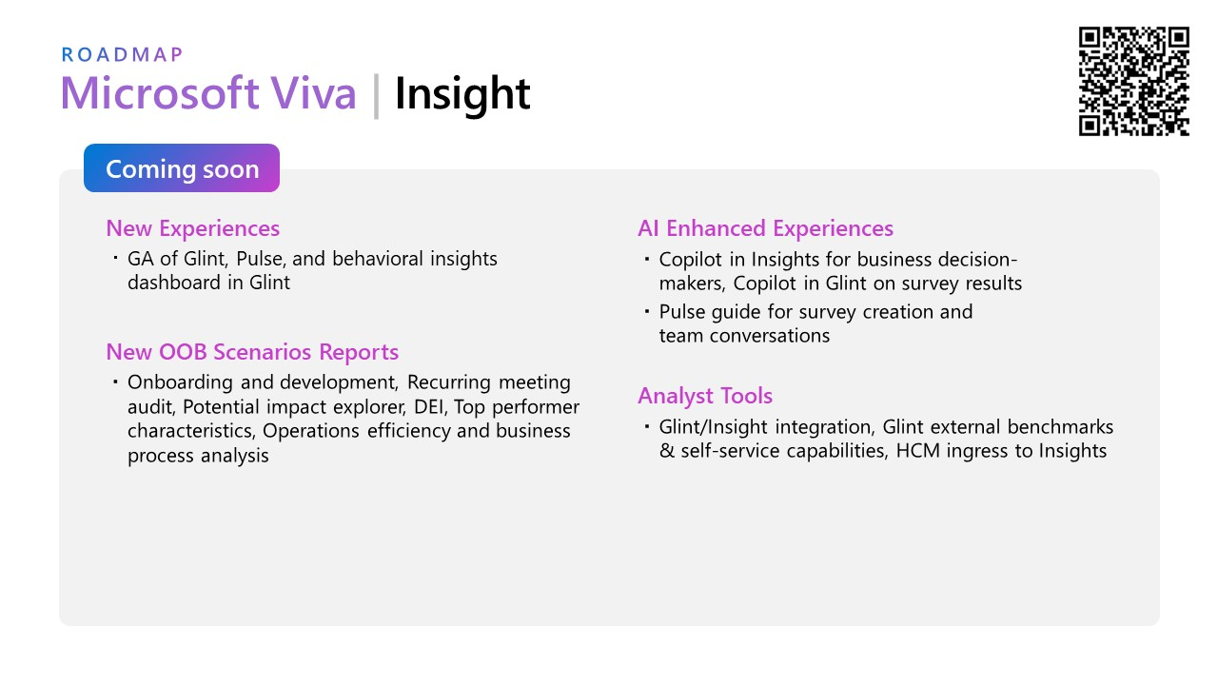
Microsoft Viva Insight Pillar

Slide 8
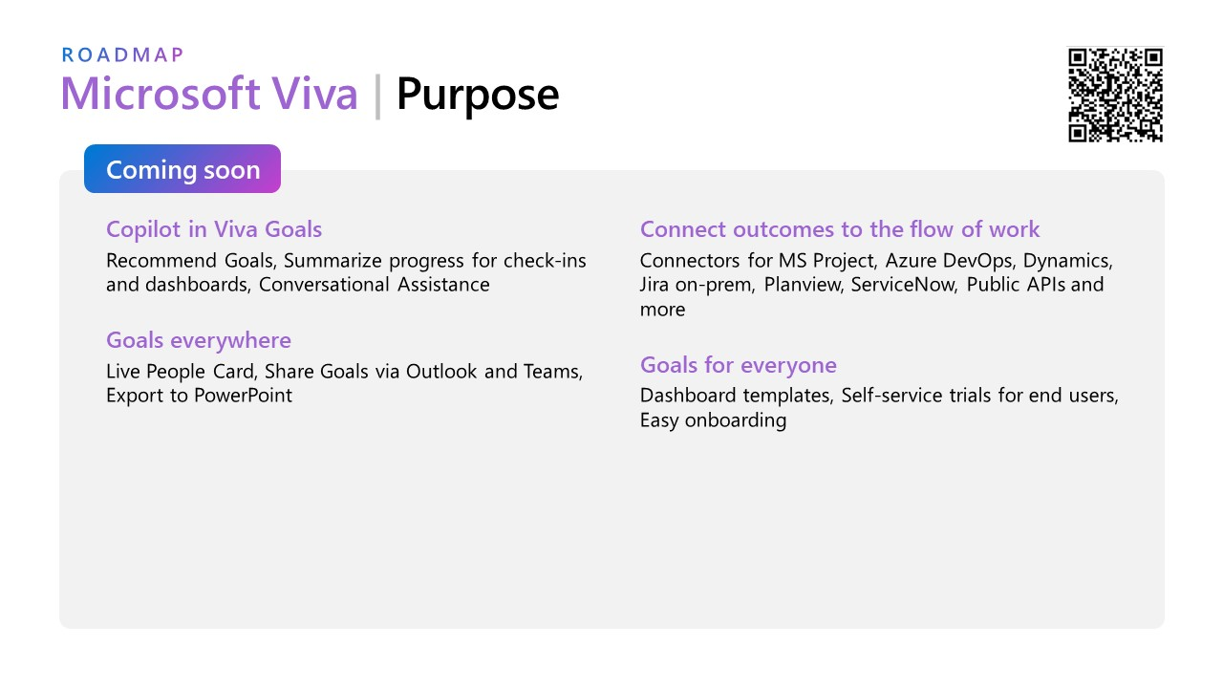
Microsoft Viva Purpose Pillar

Slide 9
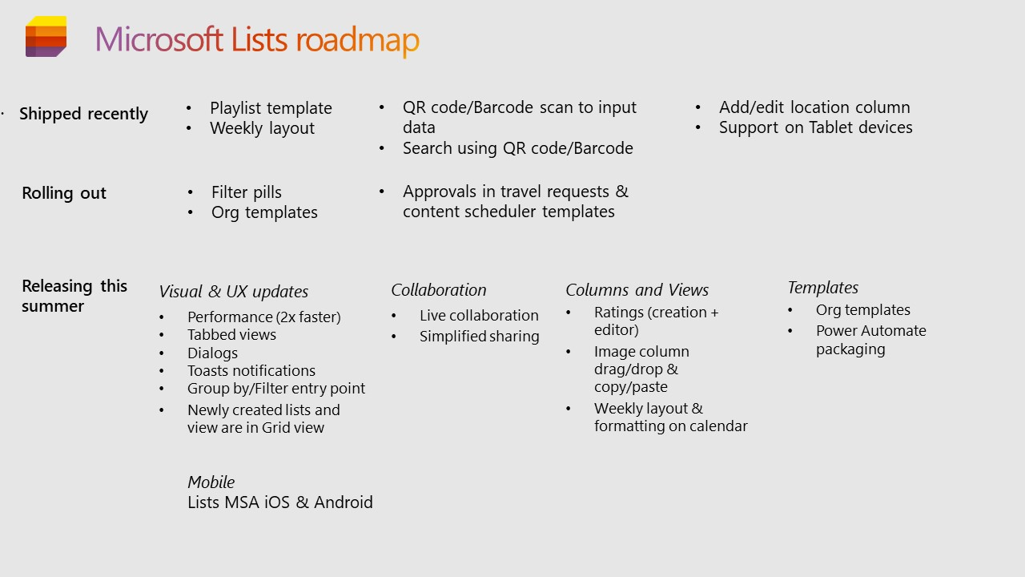
Microsoft Lists Roadmap

Slide 10
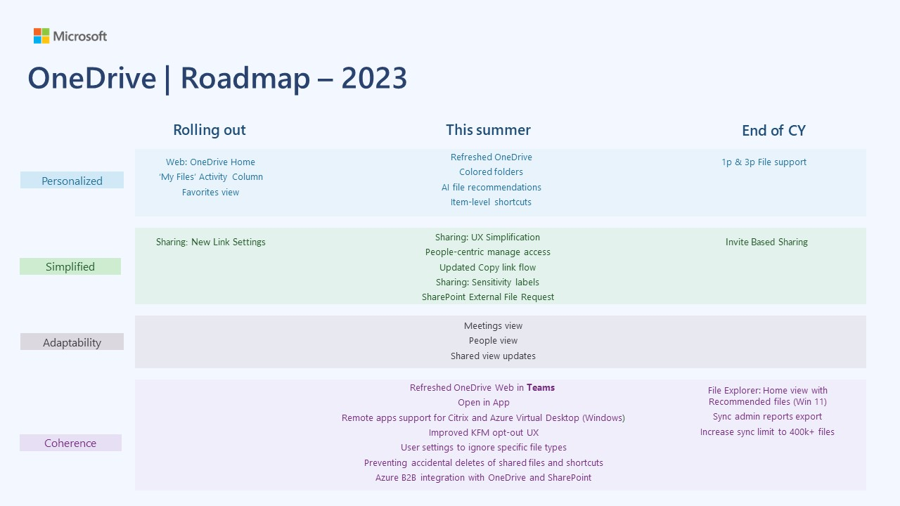
OneDrive Roadmap

Slide 11
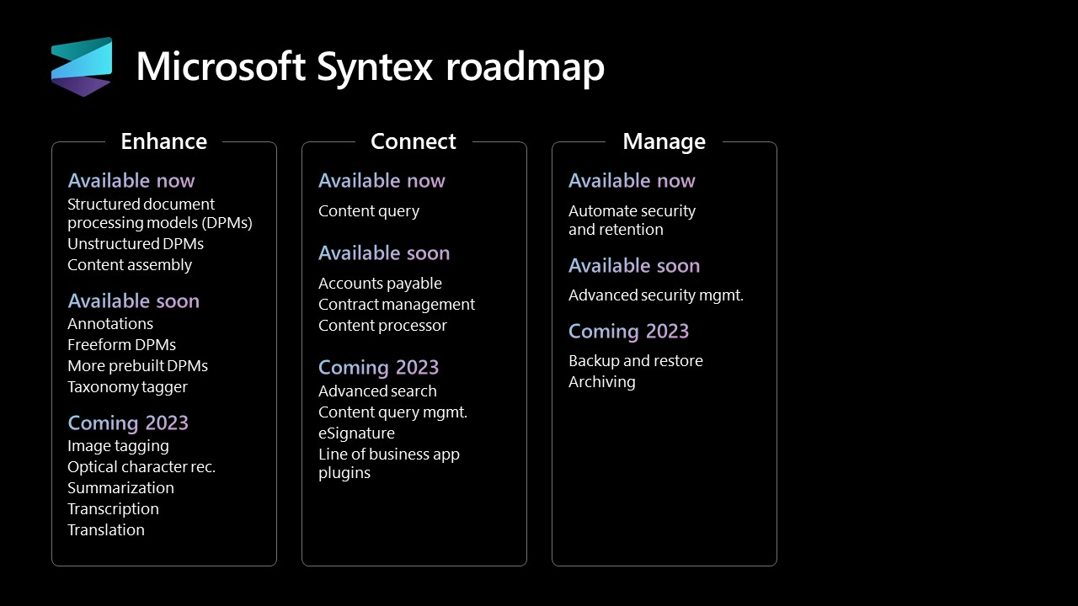
Microsoft Syntex

